Slide 1

Building Technology Leaders with
Peer Coaching
Shelee King George
Notes:
Shelee - Welcome 1 min
Introduce ourselves.

Slide 2


Nice to Meet You
Shelee King George
Director of Professional Learning
Peer-Ed
Notes:
Ask Gerald how to set up poll
How long? 3 minutes this slide and the next one

Slide 3
Role Poll
Are you a
Administrator
School leader
Teacher
Library Media Specialist
Tech Integration Specialist
Notes:
Gerald will lead.
3 minutes this slide and the next slide

Slide 4
Coach Poll
Are you
Currently a peer coach
Currently a teacher who wants to become a peer coach
Currently an administrator looking to begin a peer coaching program
Currently a administrator looking to expand an existing program
Here to learn about coaching
Notes:
Gerald will do this poll

Slide 5

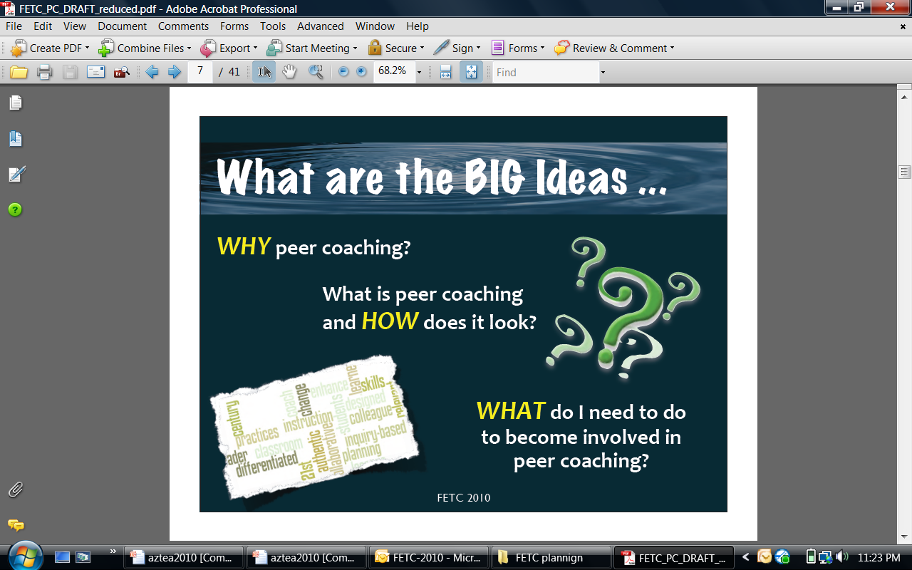
In This Session
Notes:
1 minute- Shelee
We hope to have info in this session to meet the needs of all of you. For those of you who are new to peer coaching or not currently involved this session will tell you more.
Peer Coaching is not prescriptive and looks different in each implementation. I will show you how that looks in other locations.
If you have been involved in the program already, you may want to compare your program to the story Jane has to tell about Spokane schools in the video we view later.

Slide 6
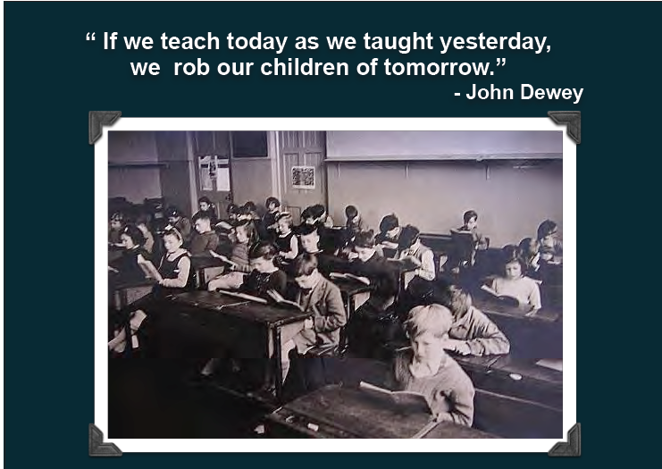
Notes:
SKG- 15 sec I think we all agree; the digital landscape is changing. We are preparing our students for a world of work that may or may not exist today.

Slide 7
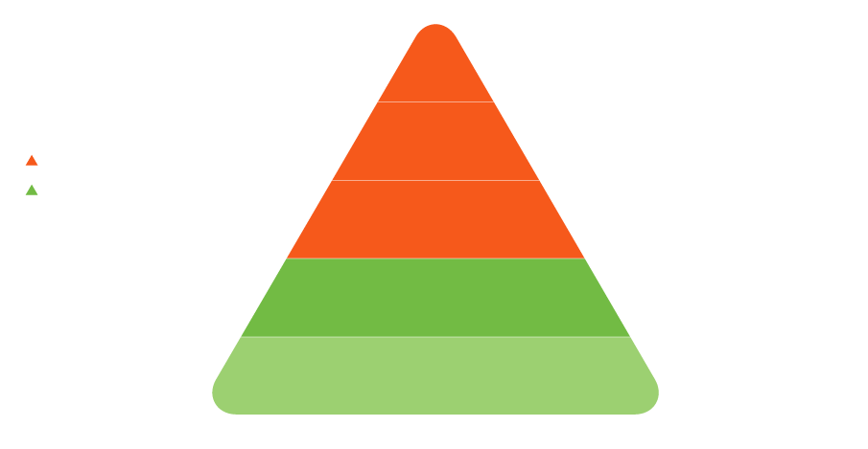
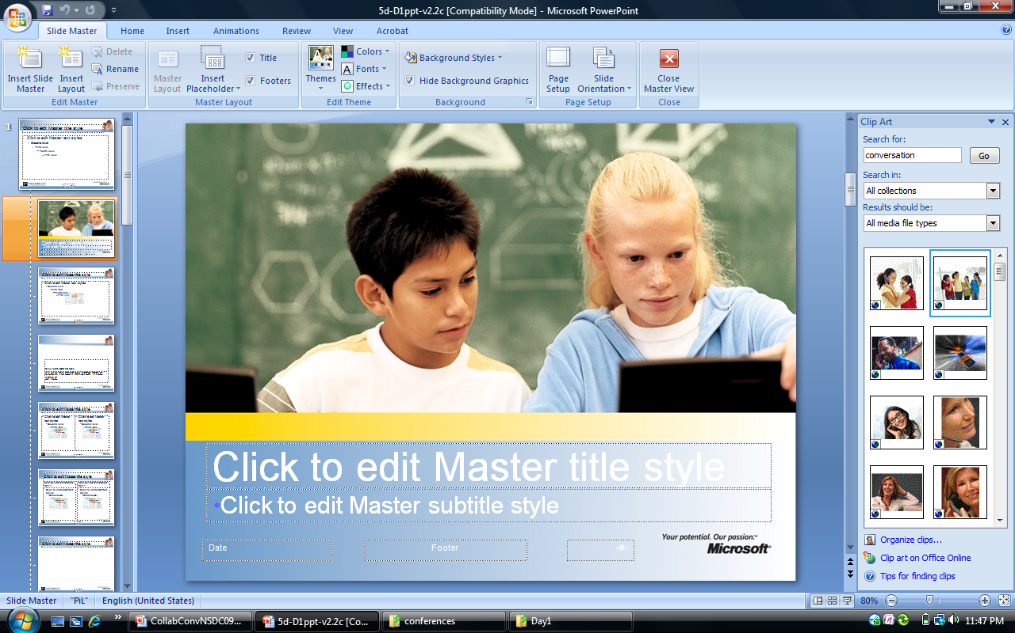
Enabling 21st-Century Schools
Policy Leader
School Leaders
Leadership
Teaching/ Learning
Teacher
Leaders
Teachers
Students
Available and
emerging technologies
Teaching/ Learning
Notes:
Shelee-2 min.
You may have several of these pieces in place.
Key points: We know it takes strong teaching and learning and supportive leadership to make 21st Century Schools. This chart outlines that support. This image comes from the Partners in Learning group at Microsoft who support programs that develop teacher, school and leadership programs. We personally owe Microsoft a big thank you for licensing the Peer Coaching Curriculum making it free to all. Now shared in over 49 countries, Peer Coaching is impacting classroom practice on multiple levels.
If we want students to use technology to gather information, to analyze and synthesize that information, to draw conclusions and share their findings with others, in other words if we want students to develop the skills they will need to be successful in school and the work place of tomorrow, it is clear that they need teachers who provide those experiences. But we need to provide support and assistance for their teachers.
If you look at the orange section, it shows those teacher leaders, let’s call them coaches, who can help other teachers to develop the skills and confidence they need to integrate technology into the teaching and learning of any subject.
The chart also reflects that fact that teachers and their teacher leaders need support from school leaders if we expect them to be successful. Teachers are quite clear when asked, they will tell you that reform efforts are successful only if those efforts are supported by school leaders. School leaders can provide the time and other resources needed to make reforms succeed. We know that no sustainable change happens without school leadership involvement.
And if we look at the top of this pyramid, its is clear that school leaders need to see that their efforts at change are also supported by regional and national educational leaders as well. Policy leaders such as the Arizona Department of Education provide vision and opportunities.
We believe that Peer Coaching can help develop the capacity of teacher leaders to play and active role in changes aimed at preparing other teachers to help students master the skills they will need for their future.

Slide 8
Classroom Impact
Type of Training | Knowledge Mastery | Skill Acquisition | Classroom Application
Theory | 85% | 15% | 5-10%
PLUS
Practice | 85% | 80% | 10-15%
PLUS
Peer Coaching Study Teams Class Visits | 90% | 90% | 80-90%
Notes:
The following table summarizes Showers’ and Joyce's research on increasing the positive impact of professional development.
The table shows the impact on classroom application when three methods of professional development are applied. When professional development focuses only on learning the theory of good instructional practice the result is a 5-10% rate of classroom application. The rate of classroom application increases slightly, to 10-15%, when the professional development experience includes opportunity to practice as well as learning about theory. Significant increase in classroom application occurs only when coaching, study teams, and/or peer visits are included with learning about theory and opportunity to practice.

Slide 9


Peer Coaching at a Glance
us.partnersinlearningnetwork.com
School Net SA
Notes:
1 min
So what is Peer Coaching? It is a simple form of JOB EMBEDDED – ongoing, professional development that provides a structured framework for helping peers share classroom practice, collaborate and impact classroom practice.
Combined with communities of learning it is the most effective professional development you can find.
Three keys to success:
Context of immediate practice
Relevant to current lessons being taught in the classroom
Ongoing as a part of daily and weekly practice
We have had a unique opportunity to share peer coaching with over 49 countries thanks to Microsoft’s partnership.
All of the Peer Coaching content is hosted on the Partners in Learning Website in the United States. Anyone can join the network. The curriculum is free to use repeatedly. Here in South Africa it is a part of School Net.
Creates opportunity to build teacher leaders world wide who help students take advantage of available and emerging technologies. Coaching looks unique in each location.

Slide 10
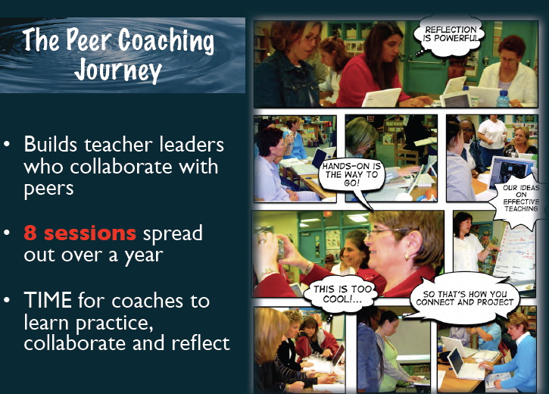
Notes:
2 min
Our journey is a non-evaluative partnership based on relationships.
Simple idea that helps Peers to collaborate with purpose.
Focus on learning activities and the meaningful use of available and emerging technologies.
Great for content specialists or new curriculum rollouts or other local initiatives such as 1:1 laptop initiatives
The curriculum is made up of 8 core sessions spread out over time. … time to LEARN, to practice, to Collaborate and then reflect.
There is a HANDOUT that describes the Curriculum in more detail available in the Moodle site Presenter Bios

Slide 11

Trustworthy
What makes a colleague trustworthy?
Notes:
Choosing the right people to become a coach is essential. Think about what makes a colleague trustworthy.
Participants submit to white board 1-2 minutes… throw out ideas
Use the BIG A to make your comments. Matt, when this page is full please click to next.

Slide 12

Trusting
Stand if you are trusting?
Notes:
Have Gerald tell me.
Coaching is a two way street- you learn to trust each other. Goodcoaches learn as much from their peers as the peer does from them.

Slide 13

Peer Coaching Focus
Trust
Tech Integration
Lesson Improvement
Coach Skills
Notes:
2 min
Choosing the right people to be a coach or facilitator is essential. Those trustworthy traits are traits of successful peer coaches.
The building blocks of the program
No real courageous conversations can happen without trust. This program is built on non-evaluative relationship founded on trust.
The peer coaching program focuses on three areas.
Designed to be a framework to build school based leaders. Works with any content area.
Let’s look at those three areas:
Coaching skills: Coaching will fail without training to develop the skills coaches need. Time to practice those skills in “coaching situations”. Role plays, protocols, and communication skills practice.
Lesson Improvement: If we want students to use emerging and available technologies, we need teachers who provide opportunities within the teaching and learning process. Teachers will spend time in deliberate collaboration when it focuses on what matters most to them3 of the 8 sessions have a heavy emphasis on lesson improvement and the role technology plays to add value to it. It permeates conversations for coaches throughout their coaching training and collaborations with their peers. This is what makes this peer coaching model different. Works great for content specialists as well as tech specialists and library media specialists.
Technology integration: Meaningful use of your available and emerging technologies. Use what you have access to. About how tech plays a role in the teaching and learning process. Again, unique to your setting.

Slide 14


A Global Perspective
Notes:
Shelee 3-5 minutes.
Peer Coaching is frequently customized to meet the needs of the local setting where it has been implemented. Since it is a framework for training coaches in three key areas (coaching skills, technology integration, lesson improvement) it aligns with any content area. THE KEY IS TO ALIGN THE PROGRAM WITH LOCAL INITIATIVES
Share the adaptation to online materials to meet the needs of a global audience as well as rural communities. Refer to handout “Peer Coaching Implementations” to read more.

Slide 15
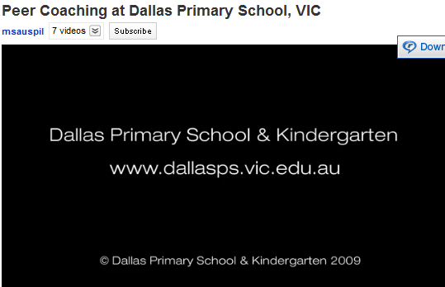
Meet Australia’s
Dallas Primary School
http://www.youtube.com/watch?v=o36yCa75aHs
Notes:
Show Video from Australia

Slide 16

If You Build it….
Promote collaborative opportunities
Become a coach
Join the Partners in Learning Network
Consider building a Peer Coaching Program
Notes:
1 minute.
Gerald, tell how to get involved through school net.
You have plenty of opportunities to take action on the information of this session. You can… read slide.

Slide 17




Questions and Answers
Use the chat area to ask your questions

Slide 18
Thank you
Shelee King George
skgeorge@peer-ed.com
Facebook.com/ThePeerCoachingPeople
peer_coaching@Twitter
Other resources can be found at
http://peercoaching2011series.wikispaces.com/
http://peercoachingwebinarbytes.wikispaces.com/
ISTE: Coaching Nets and White Paper
http://www.iste.org/learn/coaching-white-paper.aspx
Notes:
Thanks for joining us today.
Turn the session back over to Peggy.

